Slide 1
Monitoring and modeling progress in family planning: National, regional, and global trends
Family Planning Estimation Tool (FPET) Training
Philipp Ueffing, Population Division,
Department of Economic and Social Affairs, United Nations
Nay Pyi Taw, June 2019
Notes:
Today I will present on Monitoring progress in family planning: National, regional, and global trends.
This work is done by the United Nations Population Division in New York.

Slide 2
MAKING FAMILY PLANNING COUNT PROJECT
Project of the United Nations Population Division funded by the Bill and Melinda Gates Foundation (2015-2017, 2018-2020)
Improve the global community’s ability to track progress in meeting the demand for family planning
Produce estimates and projections of key family planning indicators for all women, by age groups and marital status for all countries of the world
Improve the accessibility and transparency of demographic data required for analysing the impact of family planning programs
Collaboration with Avenir Health/Track20 and the University of Massachussets to ensure consistency of methods and data used
https://www.un.org/en/development/desa/population/projects/making-family-planning-count/index.asp
Notes:
Were does the United Nations Population Division sit along Track20.

Slide 3
INTERNATIONAL COMMITMENTS
Every Woman Every Child:
Global Strategy for Women’s, Children’s and Adolescents’ Health
Program of Action:
1994 Cairo: International Conference on Population and Development
SDGs:
Sustainable Development Goals
1994
2005
2010
2012
2015
MDGs:
Millennium Development Goals
FP2020:
Family Planning 2020
Change of focus from married or in-union women to all women of reproductive age reflecting rights-based focus: the importance that family planning be available to all women, without barriers, regardless of their marital status
Notes:
What sets the framework for work of the United Nations in the field of family planning?
The most important document for our work is the Programme of Action that stems from the 1994 UN Population Conference in Cairo. The outcome was a Programme of Action which had its 25th birthday this year.
The programme of action defined reproductive rights as “Reproductive rights – basic rights of couples and individuals to decide freely and responsibly the number, spacing and timing of their children and to have the information and means to do so”.
Family Planning then became part of the Millennium Development Goals, with a short delay, in 2005.
Another important UN initiative is the Secretary General’s “Every Women, Every Child Global Strategy”. It is an interagency strategy including for example WHO and UNICEF to bring Women, Children and Adolescent Health in focus.
In 2012 the Family Planning Initiative started.
On Family Planning, when the SDGs were introduced the focus went from women who are married or in-union, to all women.

Slide 4


Let us know when you are done!
How will we know that?
Are we making progress?
Population Division is custodian agency for several SDG indicators (including 3.7.1.)
from @ComicsUniting
Notes:
The Sustainable development goals. Change from MDGs is to shift it to a global agenda and to have the countries much closer involved.

Slide 5
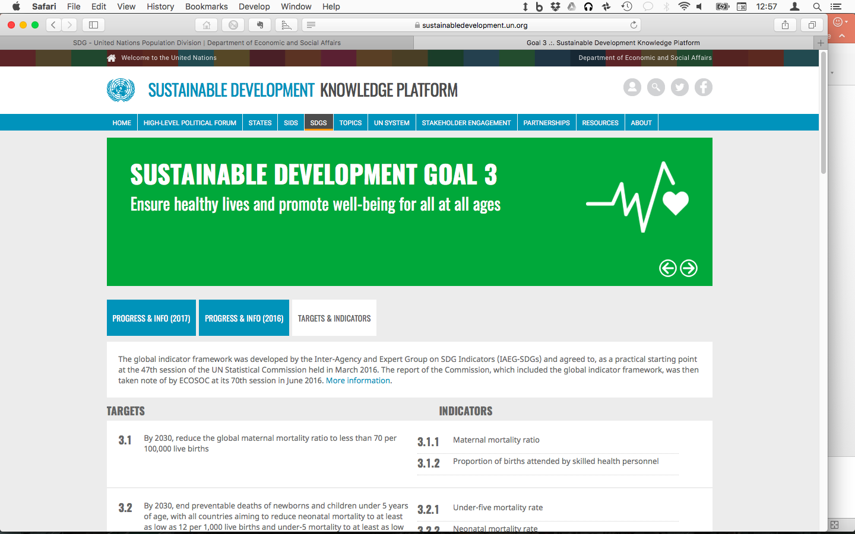
2030 AGENDA FOR SUSTAINABLE DEVELOPMENT
TARGET 3.7 | INDICATOR 3.7.1
By 2030, ensure universal access to sexual and reproductive health-care services, including for family planning, information and education, and the integration of reproductive health into national strategies and programmes. | Proportion of women of reproductive age (aged 15-49 years) who have their need for family planning satisfied with modern methods.
  “Leave no one behind” - Disaggregation: age, marital status, wealth, sub-national…
Notes:
So, as said, the Population Division is the custodian agency for indicator 3.7.1 which sits under
Goal 3 – health
Target 3.7 – Ensure universal access to sexual and reproductive health-care services, including for family planning.
The indicator itself measures demand satisfied for modern family planning, or in its full length
the proportion of women of reproductive age – these are women between the age of 15 to 49 – who have their need for family planning satisfied with modern methods.
The SDGs focus on leaving no one behind meaning to cover sub-population such as women, children, migrants, people with disability or to look at specific characteristics such as wealth differences or to look at sub-national estimates.
Therefore, disaggregated data is essential. For family planning, this has meant for us to find data disaggregated by age and marital status.

Slide 6
WHAT DO WE NEED MONITORING FOR?
Present current situation - “nowcasting”
Notes:
What do we need monitoring for?
First, to look at the present situation.
CLICK:
Here we look at demand satisfied with modern methods in 2019. It is called a nowcast because we don’t have that recent observations yet for many countries. So here we are using the model - that I will provide more details on later on – to estimate the current situation.
What else we need it for
CLICK next slide:

Slide 7
WHAT DO WE NEED MONITORING FOR?
Present current situation - “nowcasting”
Assess the changes over time
Compare countries at same point in time
Present regional and global estimates
Future path based on historical patterns
Future path if accelerated progress
How to set targets?
Notes:
Asses the changes over time.
Compare countries at the same point in time. So that we were able to do with the map I showed earlier. I am not looking at more examples as people here have worked with the FPET tool or will work with the FPET tool and understand this better later.

Slide 8

KEY INDICATORS FOR MONITORING
Contraceptive Prevalence (modern and traditional)
  $$CP=\frac{\text{number} \text{of} \text{women} \text{using} \text{contraception}}{\text{total} \text{number} \text{of} \text{women}}$$
Users
Non-User
Users
traditional
Notes:
Now we turn to the indicators that we model and which are need to estimate demand satisfied for family planning.
First we have Contraceptive prevalence.
The number of women in the population who are currently using, or who’s sexual partner is currently using, a modern or traditional method of contraception to prevent pregnancy.
CLICK

Slide 9
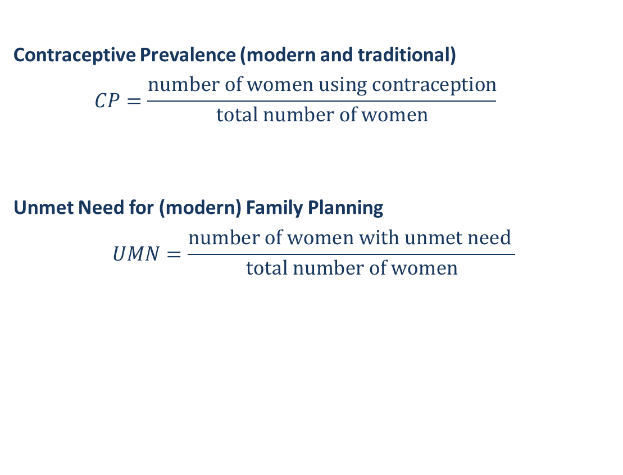
KEY INDICATORS FOR MONITORING
Contraceptive Prevalence (modern and traditional)
  $$CP=\frac{\text{number} \text{of} \text{women} \text{using} \text{contraception}}{\text{total} \text{number} \text{of} \text{women}}$$
Unmet Need for (modern) Family Planning
  $$UMN=\frac{\text{number} \text{of} \text{women} \text{with} \text{unmet} \text{need} }{\text{total} \text{number} \text{of} \text{women}}$$
Users
Non-User
Users
traditional
Users:
Met Need
Non-Users: No Need
Users traditional:
Unmet for modern
Non-Users: Unmet Need
Notes:
Unmet need:
Women with unmet need are those who are want to stop or delay childbearing but are not using any method of contraception
Aggregate-level estimate
Is not reflective of individual need at the present moment
Women with unmet need include a large subset of women who are pregnant, post-partum amenorrhea, whose unmet need status was acquired up to 33 months earlier
“Goal is to quantify the amount by which the contraceptive prevalence among all women of reproductive age would increase if fertility preference were fully and perfectly implemented”
Not exhaustive list of indicators

Slide 10
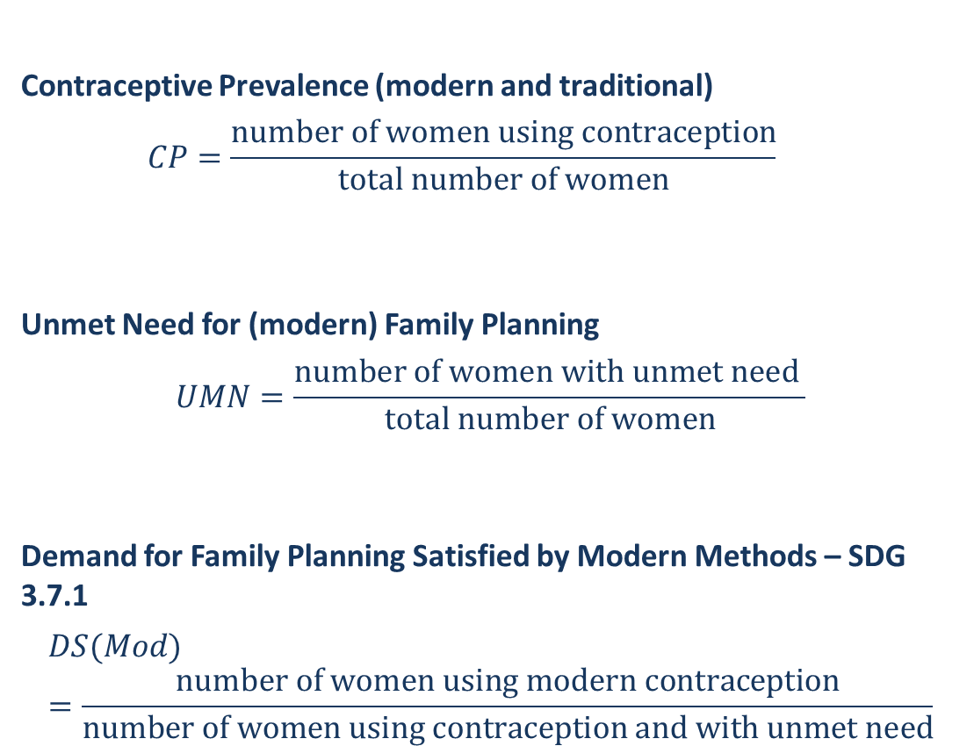
KEY INDICATORS FOR MONITORING
Contraceptive Prevalence (modern and traditional)
  $$CP=\frac{\text{number} \text{of} \text{women} \text{using} \text{contraception}}{\text{total} \text{number} \text{of} \text{women}}$$
Unmet Need for (modern) Family Planning
  $$UMN=\frac{\text{number} \text{of} \text{women} \text{with} \text{unmet} \text{need} }{\text{total} \text{number} \text{of} \text{women}}$$
Demand for Family Planning Satisfied by Modern Methods – SDG 3.7.1
  $$DS(Mod)=\frac{\text{number} \text{of} \text{women} \text{using} \text{modern} \text{contraception}}{\text{number} \text{of} \text{women} \text{using} \text{contraception} \text{and} \text{with} \text{unmet} \text{need}}$$
Users
Non-User
Users
traditional
Users:
Met Need
Non-Users: No Need
Users traditional:
Unmet for modern
Non-Users: Unmet Need
Met Demand
Total Demand
Notes:
Demand Satisfied with modern methods of contraception. So here we put in relation those women who have their demand for family planning satisfied and are using contraception compared to all women with a demand for contraception – so including those who want to stop or delay childbearing but are not using contraception.
On this graphic, what is a little unclear is use of modern and traditional methods of contraception. For the SDG traditional methods are not counted in the numerator. Women using traditional methods are classified as not having their demand for modern contraception satisfied.
The SDG indicator.
Not exhaustive list of indicators.

Slide 11
DATA FOR GLOBAL MONITORING OF FAMILY PLANNING INDICATORS
UNPD publishes global datasets of family planning indicators
Data compilations:
  World Contraceptive Use 2019 – 1,247 observations
  Estimates and projections of key family planning indicators:
  National, regional and global, for 1970-2030
  Annual revisions – since 2014 available at www.unpopulation.org
  Bayesian Hierarchical Model
  From 2019 for all women and by marital status
Global monitoring (SDGs) annually
  Countries: survey data
  Geographic and development groups: model-based estimates
  FP2020 annual reporting and FPET tool – using same methodology
Notes:
Here is what the UN Population Produces in terms of data sets and reports.
Survey data compilation:
World Contraceptive Use 2019. 1,247 observations.
For about 650 of them we have observations for both married and unmarried women
Estimates and projections of key family planning indicators
These are the model outputs. The observations is what goes into the model.
The model produces national, regional and global estimates from 1970 to 2030
For comparative purposes over time and across countries and for providing regional and global estimates
The Population Division of the Department of Economic and Social Affairs provides the international community with timely and accessible population data and analysis of population trends and development outcomes for all countries and areas of the world.

Slide 12
SURVEY DATA
Source: World Contraceptive Use 2019
Notes:
Here the number of surveys that are included in our data base.
We see the MICS, DHS and the PMA surveys recently.
Older survey series such as the World Fertility Survey and Contraceptive Prevalence Surveys.
But also the large number of national surveys.

Slide 13
SURVEY DATA INCLUDING UNMARRIED WOMEN
Source: World Contraceptive Use 2019
Notes:
Here is the availability on information about unmarried women from these surveys.
In the sixties and seventies not much available. Has become much more frequent.
However, for some surveys the results were actually not published and we need to get the unmarried women esimates from micro-data. These are less available for earlier times.
Myanmar had unmarried women in their last DHS.

Slide 14
MODEL FOR FAMILY PLANNING INDICATORS FOR ALL WOMEN OF REPRODUCTIVE AGE
Taking results of the Bayesian hierarchical model developed for married/in-union women
Developing the model for unmarried women
Calculating estimates for all women by summing results for married and unmarried women using as weights the population by marital/union status
Resources available at: www.unpopulation.org
Wheldon et al (2018). Methods for estimating and projecting key family planning indicators among all women of reproductive age. Technical paper 2018/2. United Nations. New York.
World Contraception Use series – for survey-based observations
Implemented in FPET tool (in collaboration with UMass and Track20 teams)
Notes:
Now let’s talk about the statistical model to produce estimates and projections for all women of reproductive age.

Slide 15
ALL WOMEN ESTIMATES - WORKFLOW
Development of new model for unmarried/not-in-union women (UWRA)
Review of surveys in the data compilation World Contraceptive Use to determine available surveys providing family planning estimates among unmarried/not-in-union women (UWRA)
Classify countries according to geography and sexual activity among UWRA
Estimates included in the compilation of World Contraceptive Use 2019
Assign biases and perturbations
Estimates and projections of family planning indicators for unmarried/not-in-union women (UWRA)
Proportion of women who are married or in-union from Estimates and Projections of Women of Reproductive Age Who Are Married or in a Union: 2018 Revision based on
World Population Prospects 2017 and World Marriage Data 2017
Estimates and Projections of Family Planning Indicators 2019 for married/in-union women (MWRA)
New estimates and projections of family planning indicators for all women of reproductive age (WRA)

Slide 16
USING BAYESIAN HIERARCHICAL MODEL
Based on observed past experiences and theoretical background of contraceptive uptake in populations (as diffusion behavior)
Hierarchical modelling allows “sharing” of information among countries which is useful when data are sparse
Use the relationship between indicators – for example, unmet need and contraceptive prevalence
  If no unmet need survey observation, are there observations on contraceptive prevalence? Using country-specific relationship and/or systematic model
Adjust for some biases of survey observations – age groups covered, population, methods
Bayesian inference yields estimates of central trend and uncertainty, which is useful because uncertainty is inherent in survey data and should be accounted for

Slide 17
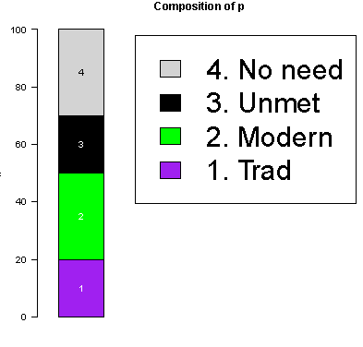
Composition by CP Status
Goal:
Estimate/project the composition of married/unmarried women 15–49 in in each of four FP categories
  Contraceptive use (traditional)
  Contraceptive use (modern)
  Unmet need for family planning
  No need for family planning
Constraint:
For any country, year, all proportions must sum to unity.

Slide 18
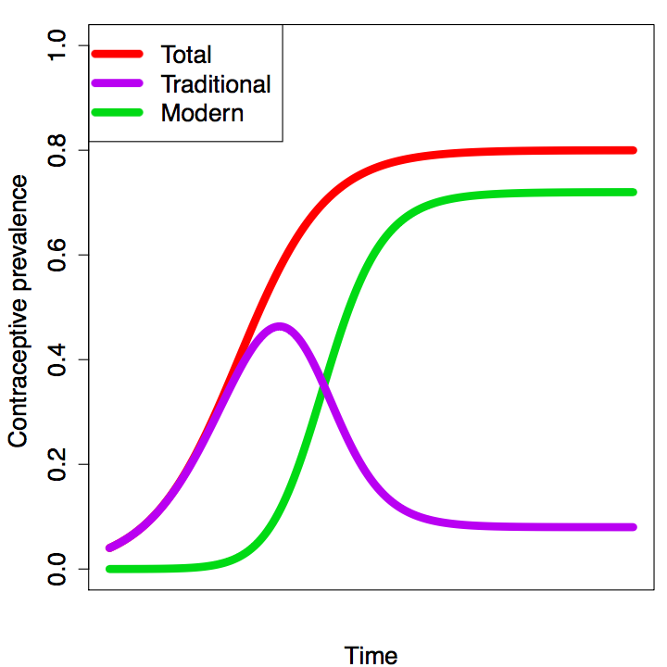
Logistic Growth Curves
We model as logistic growth curves the systematic trend of
total prevalence and
share of modern prevalence among total prevalence
This is a ‘diffusion’ model for uptake of CP. Different countries are at different stages of the growth curve.

Slide 19
Logistic Growth Curves Parameters
Flexible curves for various values of (a) timing, (b) pace, and (c) asymptote
Different values for married and unmarried women models
In practice, only small portion of the full curve is observed by data
timing
(b) pace
(c) asymptote
[pace and asymptote constant]
[timing and asymptote constant]
[pace and timing constant]

Slide 20
Logistic Growth Curves with Distortions
Adding autocorrelated distortions completes the model.
These allow for deviations from the systematic trend.

Slide 21
Why hierarchical model?
Many observations?
  Estimate driven by country data
Few or no observations?
  Estimate driven by estimates within the sub-region
Different geographic hierarchies for married and unmarried women
Married model:
World level
Major region (e.g., Africa)
Subregion (e.g., Eastern Africa)
Country (e.g., Kenya)
Unmarried model:
World level
Subregion (e.g., Eastern Africa)
Sexual activity level (e.g., low)
Country (e.g., Kenya)
Notes:
Now why is it a hierarchical model.
As pointed out, data can be sparse. So in the absence of data for a country, we look to learn about a possible trend from countries that are similar. And, as we learn from the 1st rule of geography, things that are closer are also more similar.
So in the married model, a country learns from the subregion (you have to look at this in reverse), and from the major region, and from the world level.
For the unmarried women model, solely using the geographic proximity didn’t work so well. A major factor that needed to be accounted for in the model is sexual activity, especially where it is very low. So countries with very little sexual activity outside marriage have been set in relation in the model.
We can see the hierarchy groupings in the next slides.

Slide 22
Hierarchical model for married women
Europe
  Northern Europe
  Eastern Europe
  Western Europe
  Southern Europe
Northern America
Asia
  Western Asia
  Central Asia
  Southern Asia
  Eastern Asia
  South-Eastern Asia
Latin America & the Caribbean
  Central America
  Caribbean
  South America
Africa
  Northern Africa
  Western Africa
  Central Africa
  Eastern Africa
  Southern Africa
Oceania
  Micronesia
  Melanesia
  Polynesia
  Australia and New Zealand
Notes:
Here we have the subregions and major regions. Colour shows the major regions and the shading indicates the subregions. Myanmar for example is in the South-eastern Asia group. So it would be primarily influenced by these if data are available. If not the model would look for major regions and the global lebels.
I should point out though: What influences the model most are survey observations. We model because we lack data and modelling is always a simplification.

Slide 23
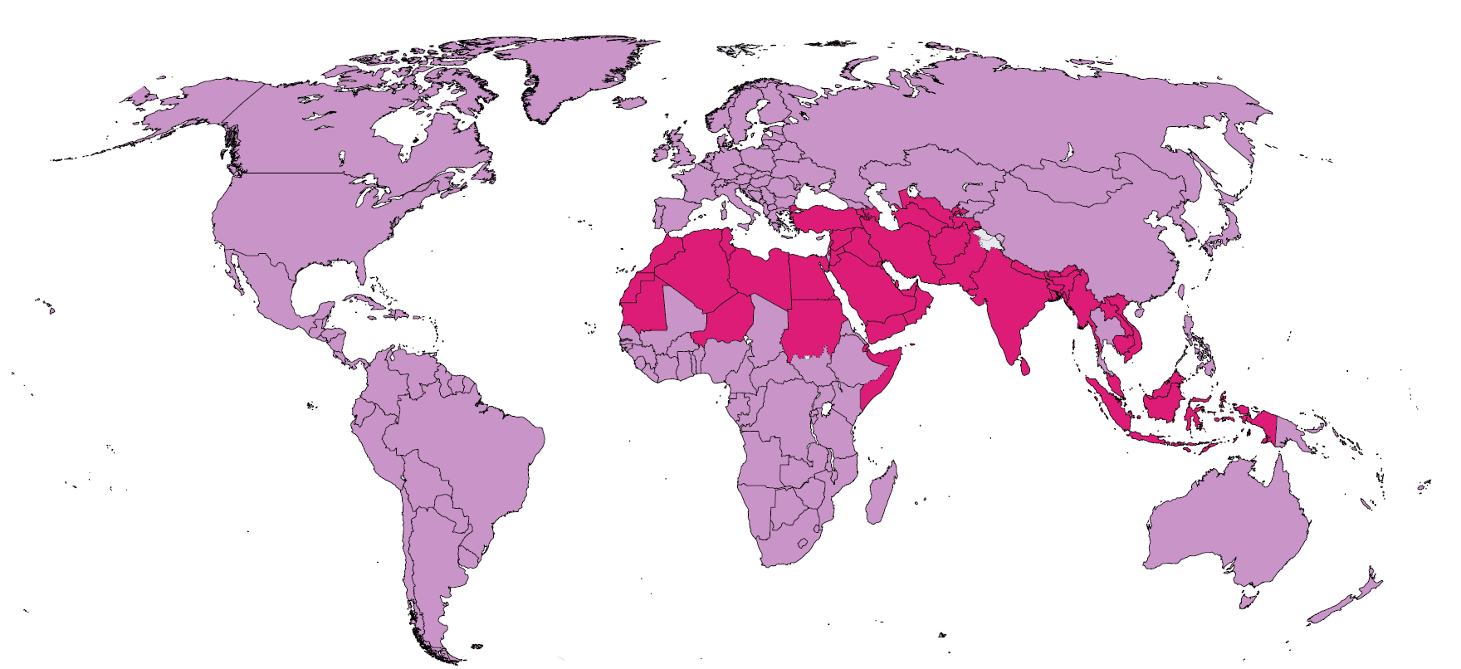
Hierarchical model for unmarried women
Low level of sexual activity
among unmarried women
Higher levels of sexual activity
among unmarried women
For unmarried women, the hierarchy includes additionally information on sexual activity among unmarried women – survey data on sexual activity, on the acceptance of premarital sex and sex between unmarried adults (PEW, WFS)
Notes:
Here the added hierarchy of sexual activity for unmarried women. We can see how Northern Africa, Western Asia, Southern Asia and South-east Asia have many countries in this group.
Thailand has upwarding trends in sexual activity among unmarried women and is not part of this group.

Slide 24
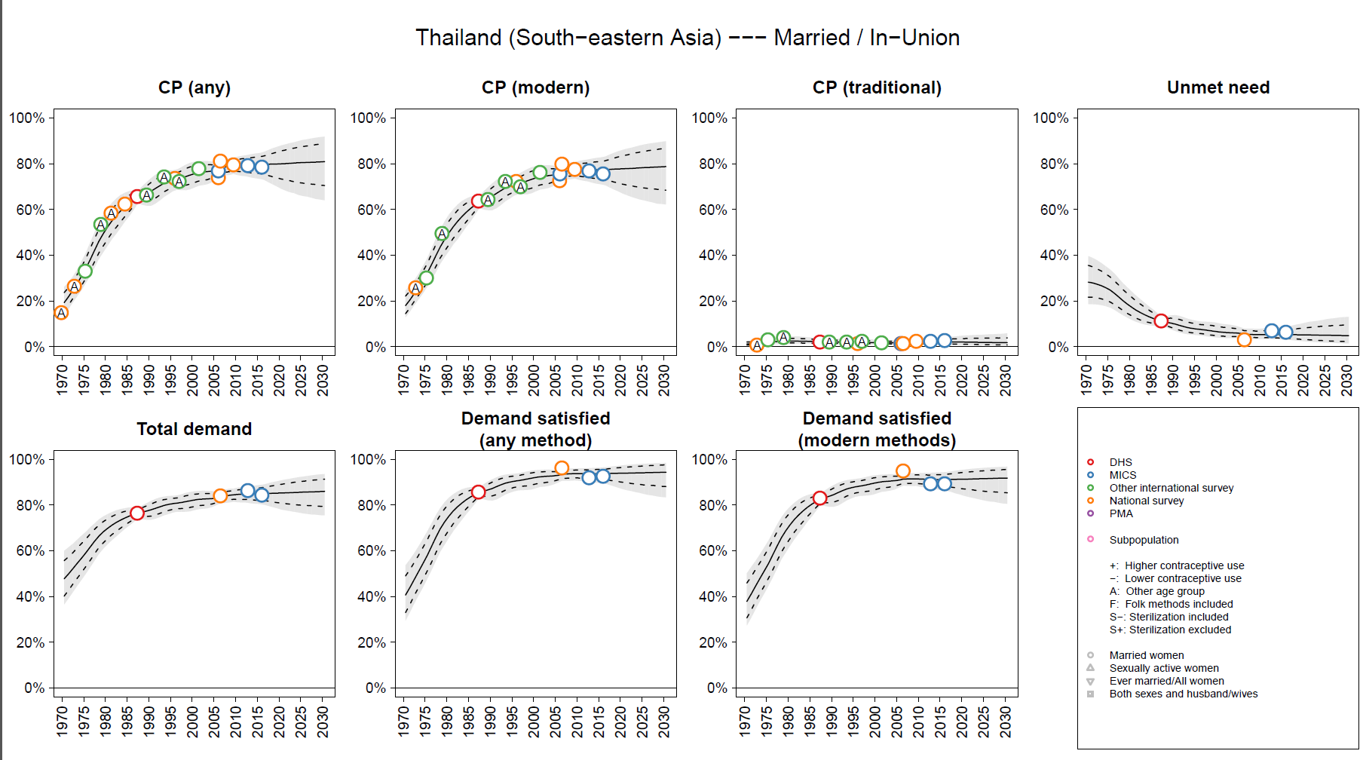
Example Outputs: MARRIED (Thailand)
Notes:
Here the modelling output for Thailand. This is just a quick walk through to show the modelling results.
Margaret will go into more detail with country examples.
We have 7 panels. This is for married women.
CP, CP modern, CP any and Unmet Need in the top row.
Total demand, Demand satisfied by any method, Demand satisfied by a modern method.
You see for Thailand a mix of survey sources.
DHS and MICS,
National Surveys and other international survey series.
Some estimates carry a bias. In this case an age bias which the model corrects for.
We also see that for Unmet Need and Demand satisfied the available data are much less.
Now the relationship can be taken from other surveys in Thailand and applied to the contraceptive prevalence rate of these surveys.
We can also see how Thailand’s CP went up strongly in the 1970 and has been stagnant at a high level recently.
From the beginning modern methods have been dominant. At the same time, unmet need has declined.
Because there are many data points the uncertainty is quite small.

Slide 25
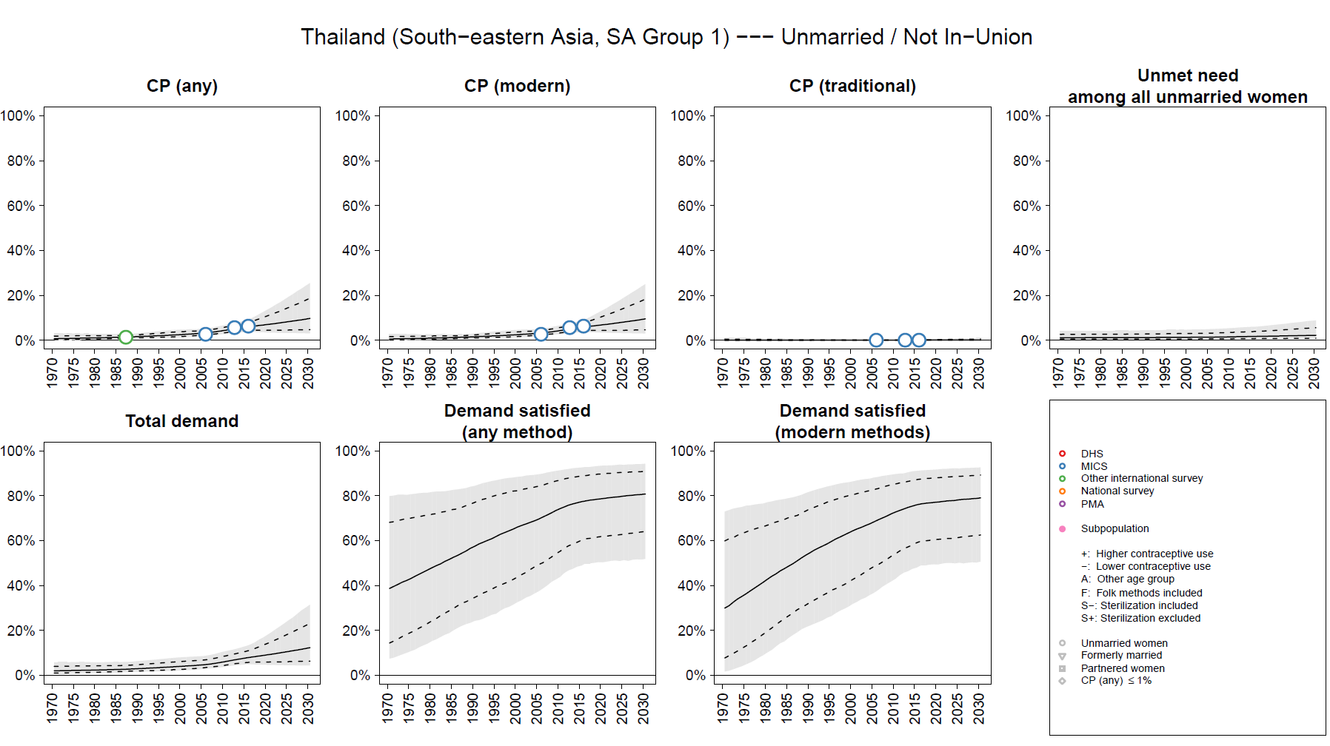
Example Outputs: UNMARRIED (Thailand)
Notes:
So how is it for unmarried women?
Much less data is available. Only from the latest MICS surveys and only for contraceptive prevalence.
Contraceptive Prevalence is much lower. This is because remember many unmarried women are not sexually active.
For unmet need and demand satisfied we do not have any data. That is why the uncertainty intervals are much wieder.

Slide 26
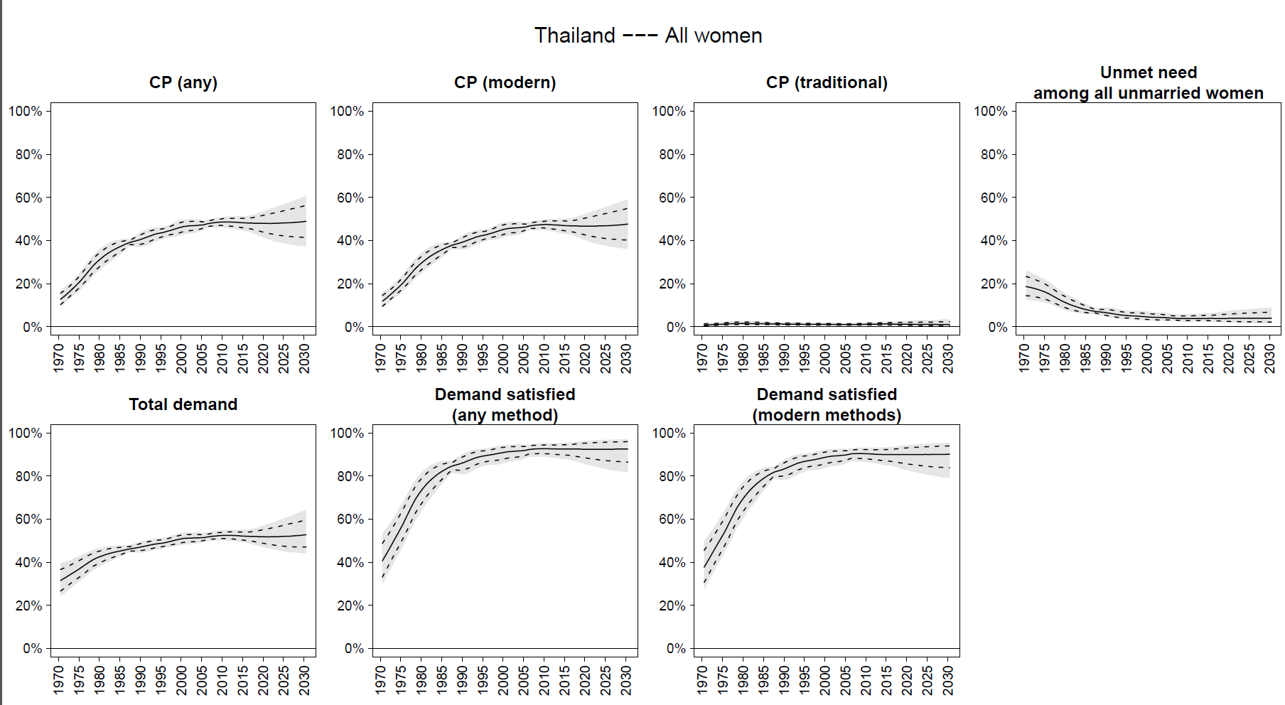
Example Outputs: ALL WOMEN (Thailand)
Notes:
For all women, we add together the results for married and unmarried women.
All women is actually not modelled. We are not fitting a line through all women estimates. That is why we are not showing any data.

Slide 27
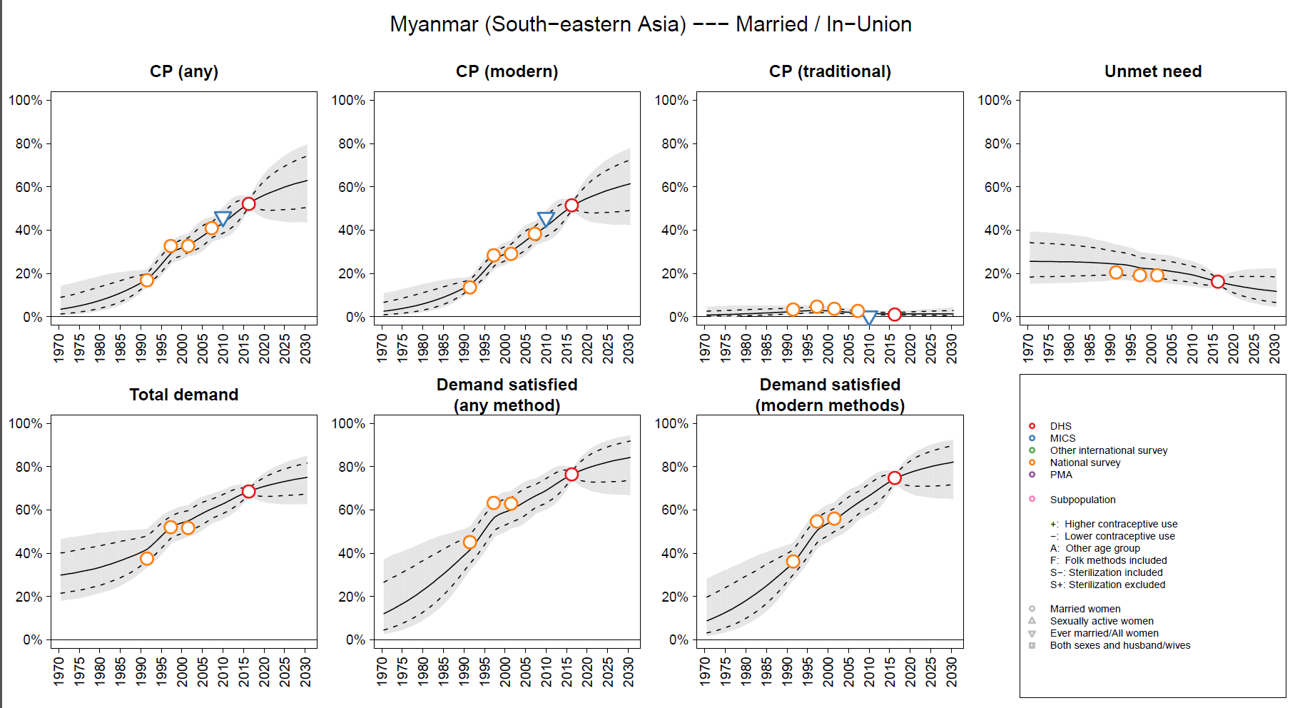
Example Outputs: MARRIED (Myanmar)
Notes:
Here the results of our global model for Myanmar.
We cannot go detailed into country specific as is done by Track20.
So we do not add service statistics to inform the trend.

Slide 28
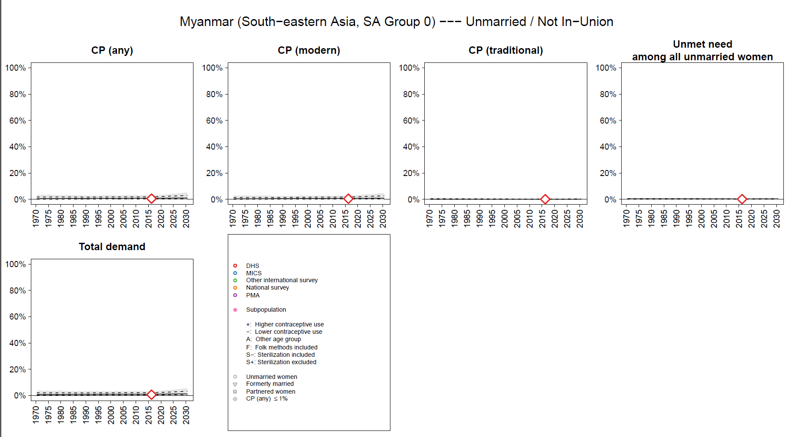
Example Outputs: UNMARRIED (Myanmar)
Notes:
For unmarried women, as far as we know, the latest DHS is a first nationally representative survey that includes unmarried women in the family planning module of the questionnaire.
Please let us know about other surveys. But we only have one observation from DHS.
And, again, because sexual activity among unmarried women is low the family planning indicators are low.
And, in contrast to Thailand, contraceptive prevalence is projected to remain relatively low. This is influenced by the grouping by sexual activity.

Slide 29
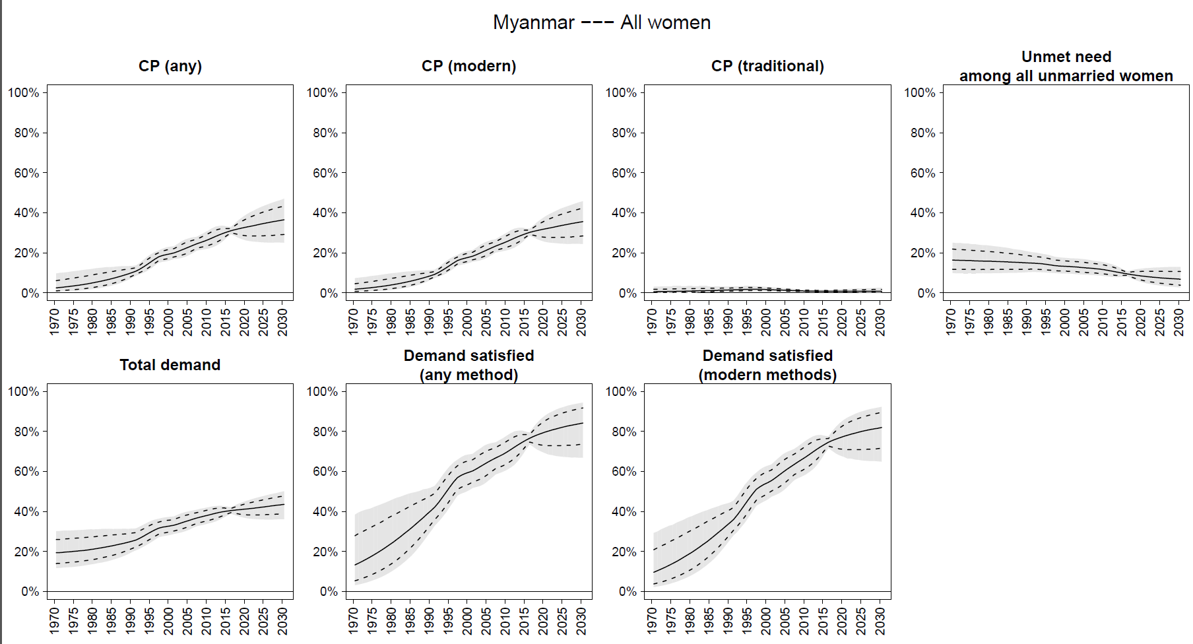
Example Outputs: ALL WOMEN (Myanmar)
Notes:
Lots of DHS data

Slide 30
THANK YOU!
Further resources:
www.unpopulation.org

